Slide 1


2021 Student Leaders’ Choices over the Years

Slide 2
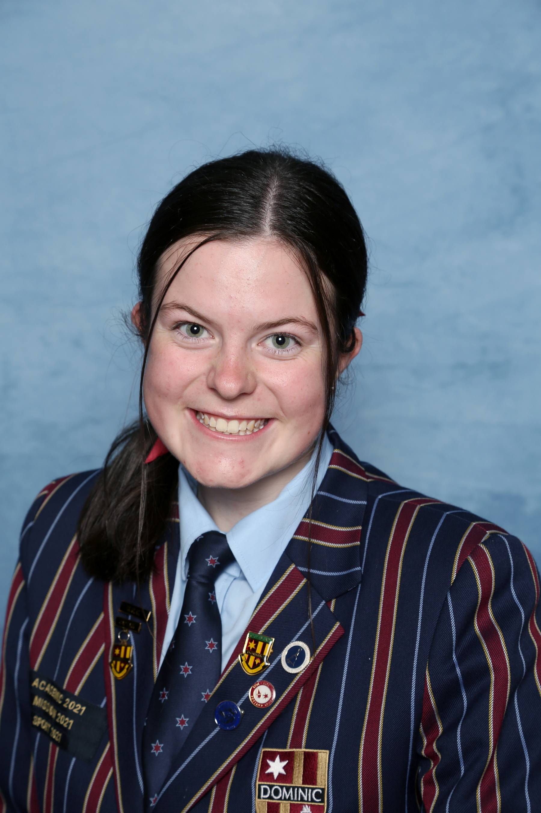

Rachael Glidden
Year 8 Electives
Drama
Home Economics
Music
Visual Art
Year 9 Electives
Child Studies
Introduction to Psychology and Sociology
Sport Science
Year 10 Electives
Creative Writing
Life Sciences
Sport Science

Slide 3
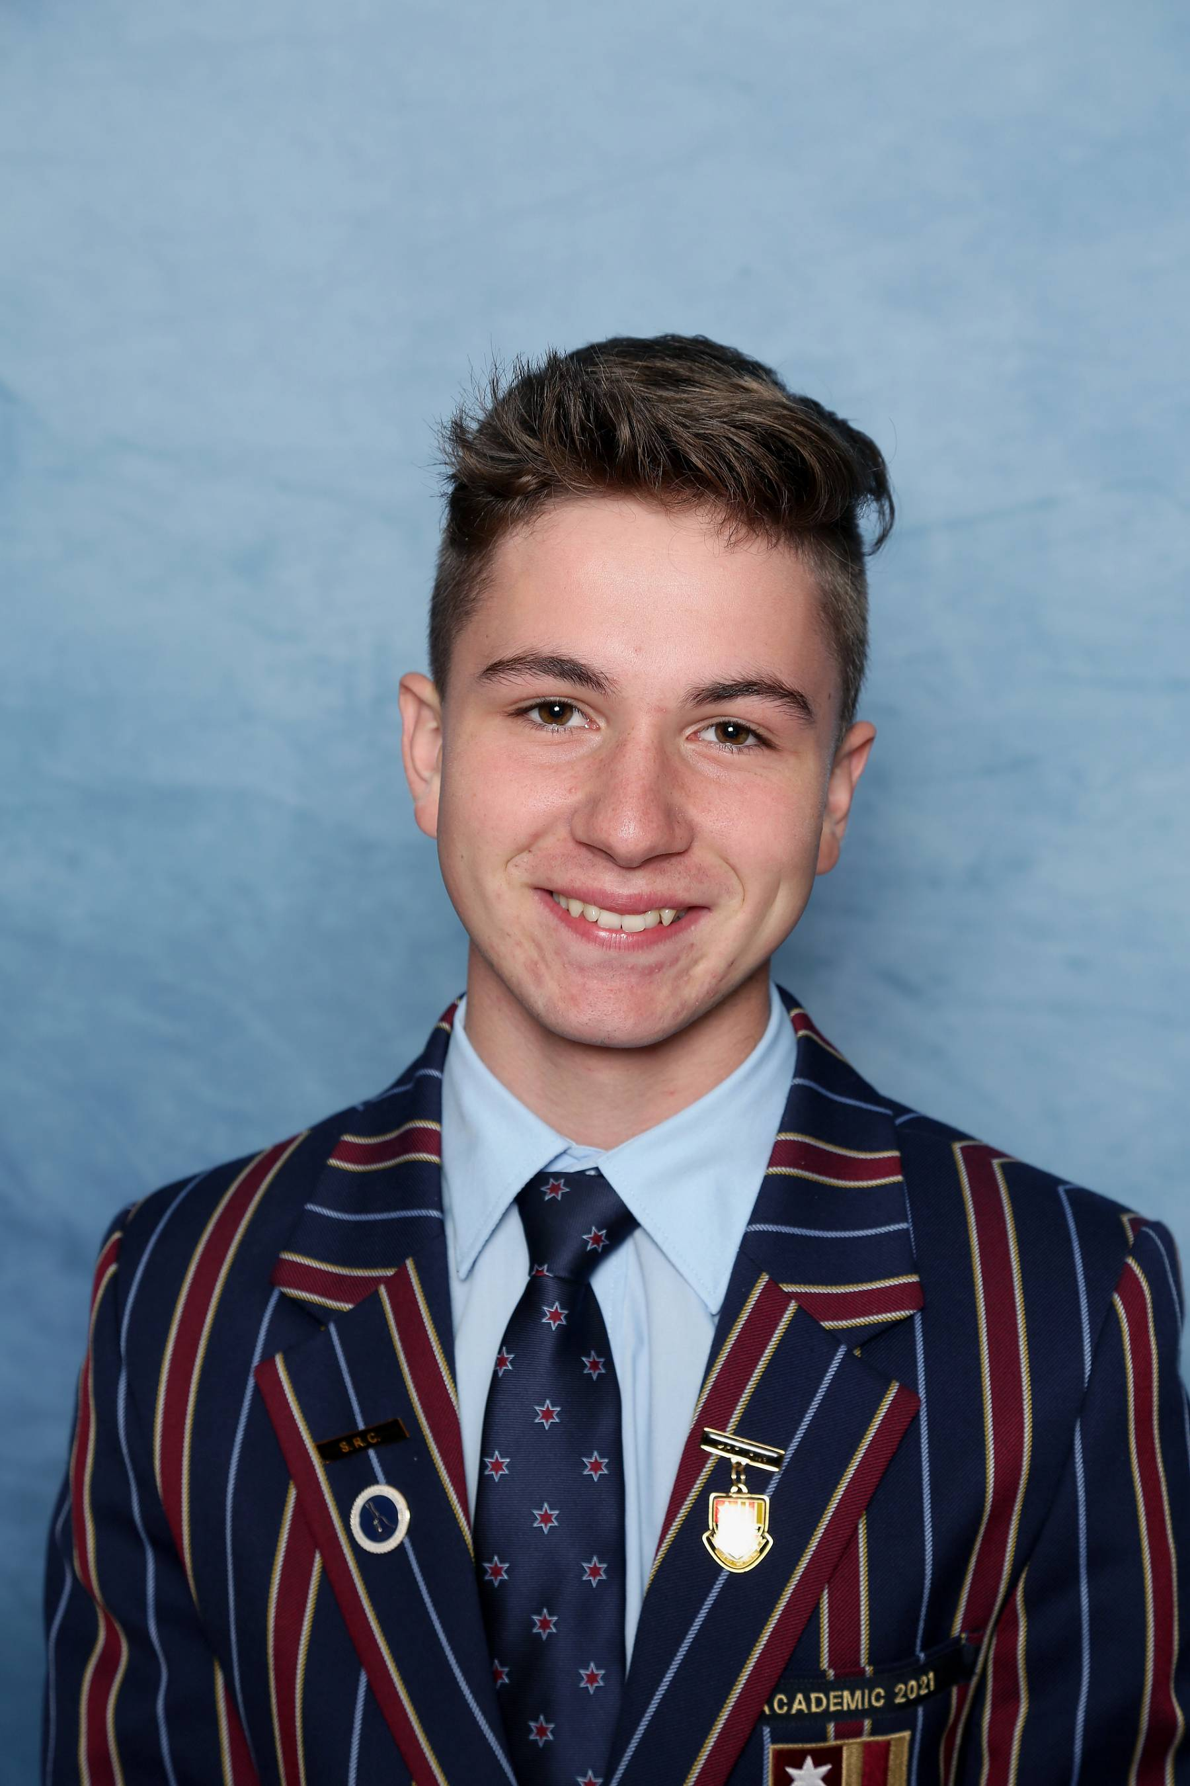
Justin Goodrick
Year 8 Electives
Digital Technologies
Drama
Japanese
Music
Year 9 Electives
Animal Husbandry and Marine Studies
Introduction to Psychology and Sociology
Life Sciences
Year 10 Electives
Creative Writing
Life Sciences
Physical Sciences

Slide 4
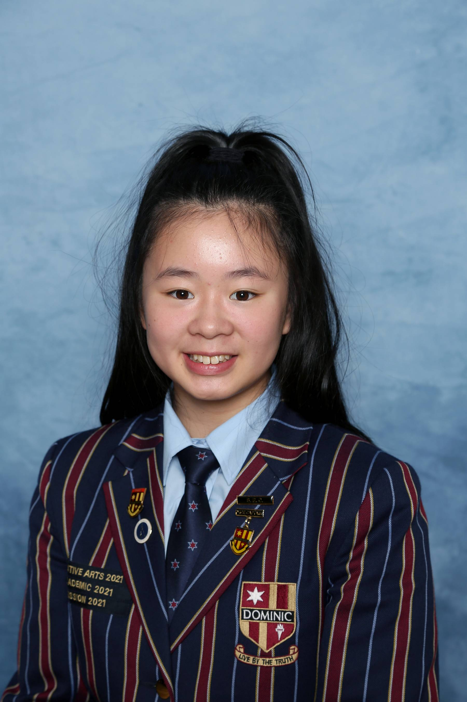
Zoelle Lin
Year 8 Electives
Digital Technologies
Dance
Japanese
Music
Year 9 Electives
Dance
Life Sciences
Japanese
Year 10 Electives
Mathematics 10A Plus
Physical Sciences
Japanese

Slide 5
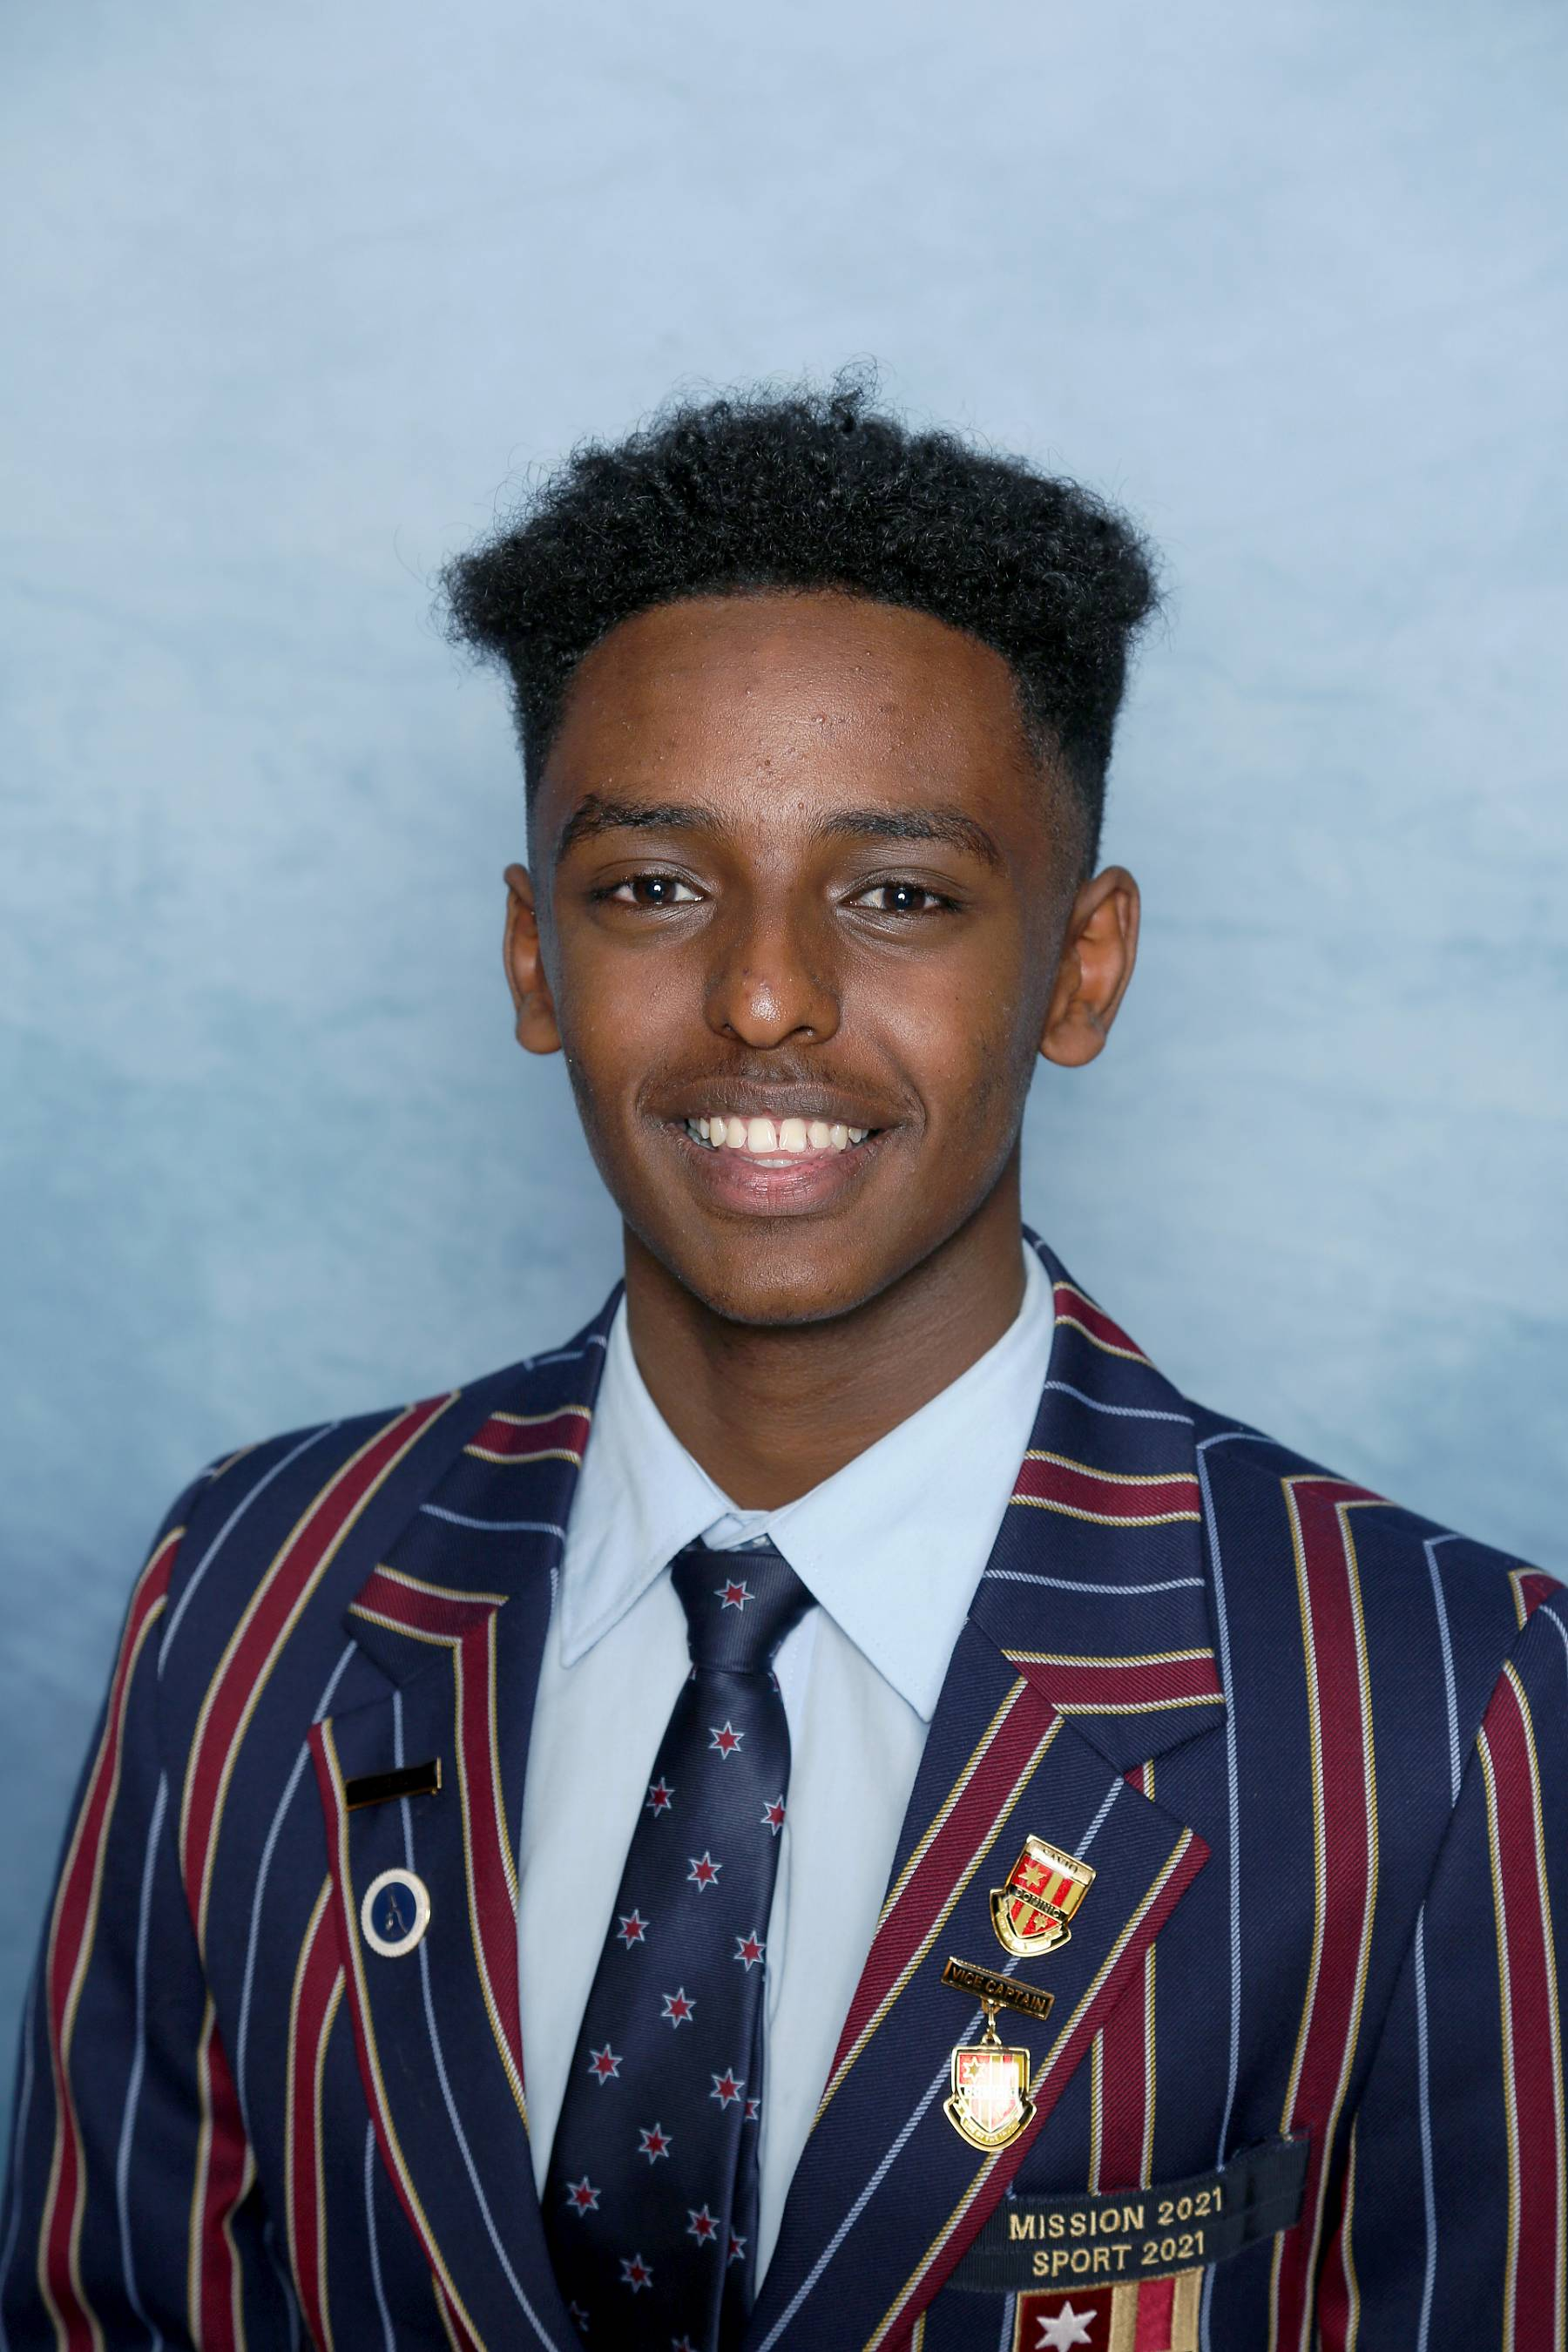
Solomon Kidane
Year 8 Electives
Drama
Home Economics
Music
Visual Art
Year 9 Electives
Athletic Development
Media Arts
Sport Science
Year 10 Electives
Athletic Development
Commerce
Sport Science

Slide 6

Sarah Watson
Year 8 Electives
Design in Wood
Home Economics
Drama
Visual Art
Year 9 Electives
Animal Husbandry and Marine Studies
Food Technology
Visual Art
Year 10 Electives
Animal Husbandry & Marine Studies
Outdoor Education
Introduction to Construction (VET)

Slide 7
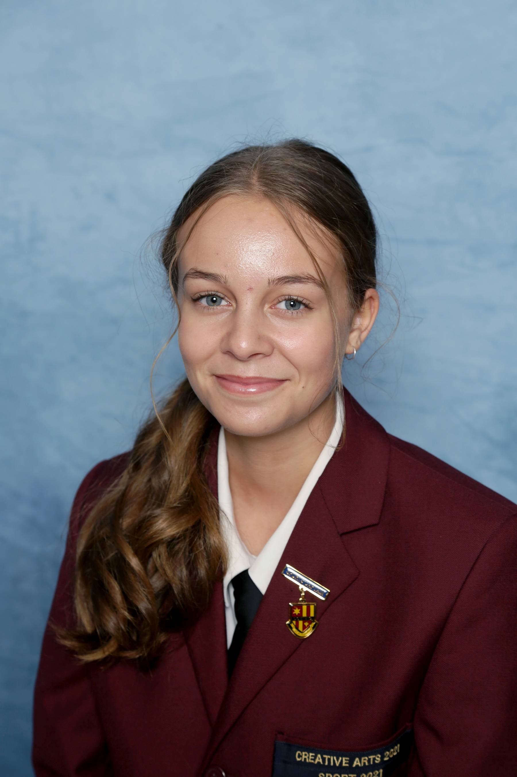
Lily Bowerman
Year 8 Electives
Dance
Home Economics
Drama
Music
Year 9 Electives
Music
Food Technology
Outdoor Education
Year 10 Electives
Athletic Development
Child Studies
Visual Art

Slide 8
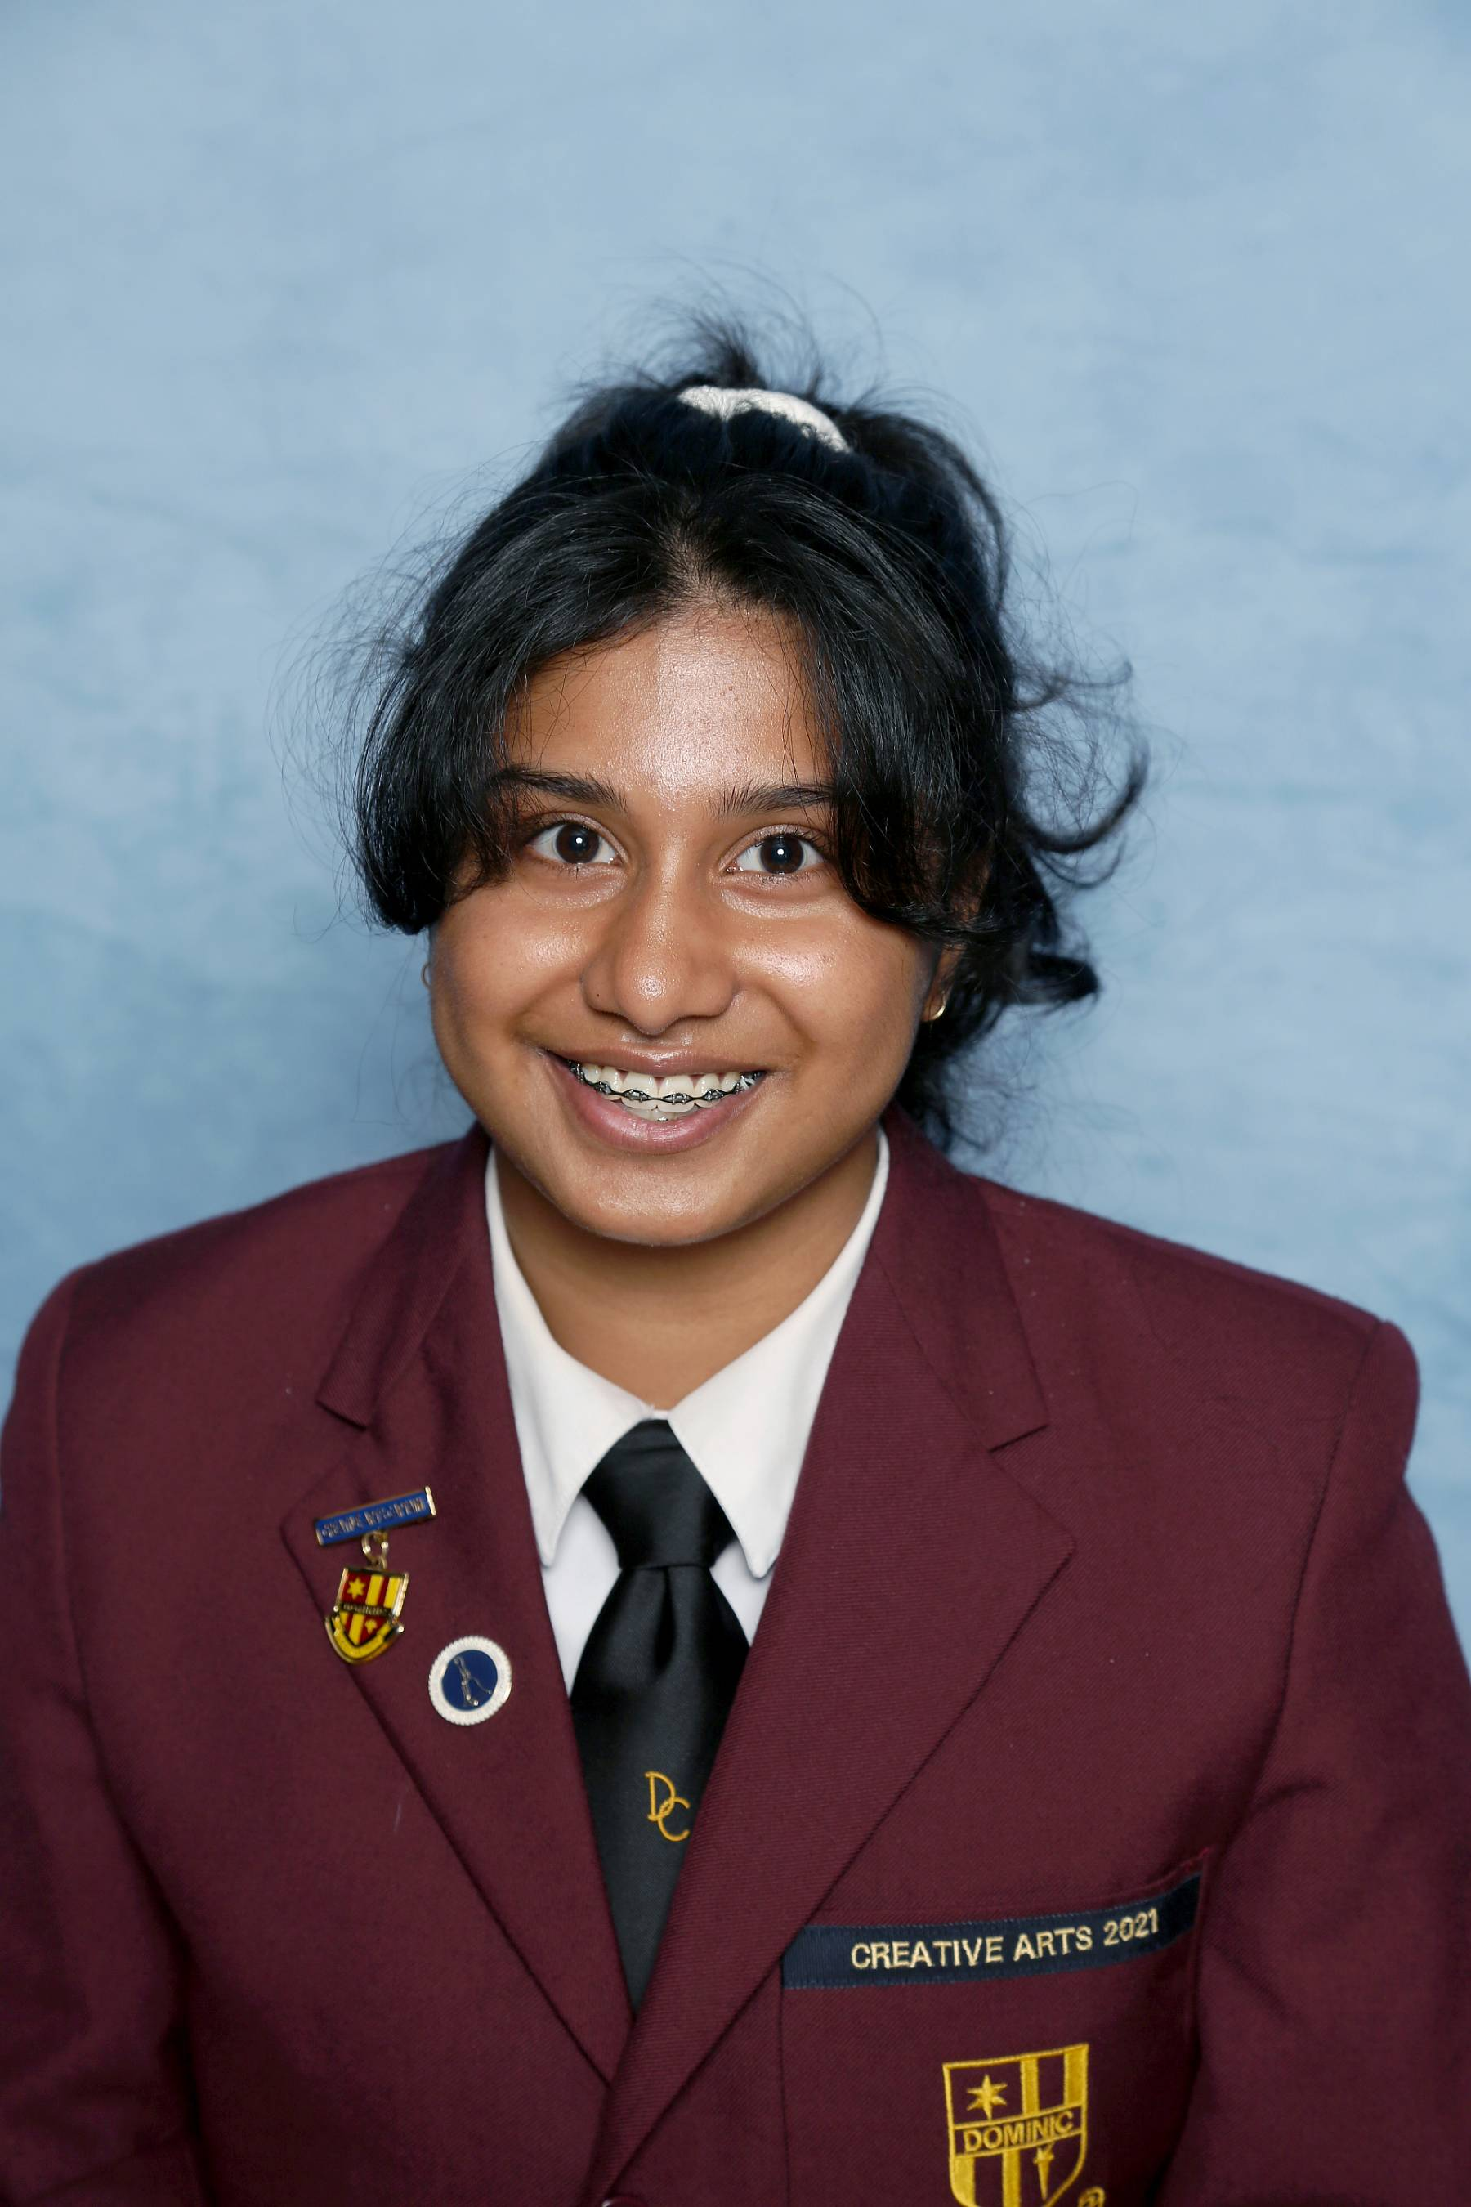
Rani Roy
Year 8 Electives
Dance
Home Economics
Drama
Japanese
Year 9 Electives
Drama
Introduction to Psychology and Sociology
Media Arts
Year 10 Electives
Commerce
Child Studies
Drama

Slide 9
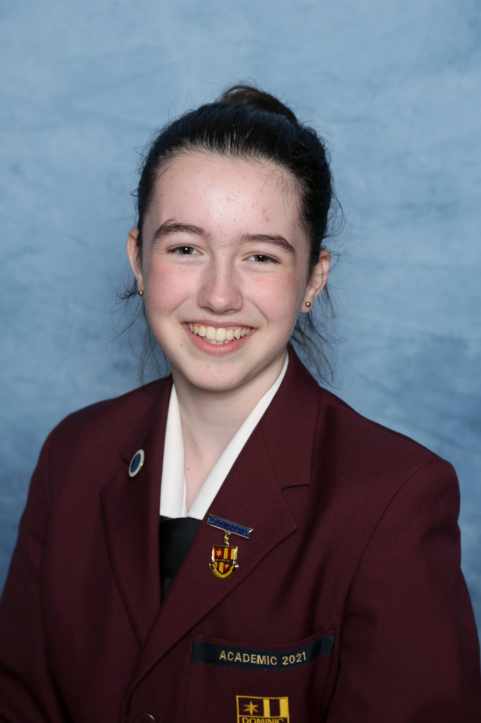
Amy Bryant
Year 8 Electives
Dance
Digital Technologies
Drama
Home Economics
Year 9 Electives
Creative Writing
Life Sciences
Mathematics Extension
Year 10 Electives
Creative Writing
Mathematics 10A Plus
Media Art

Slide 10
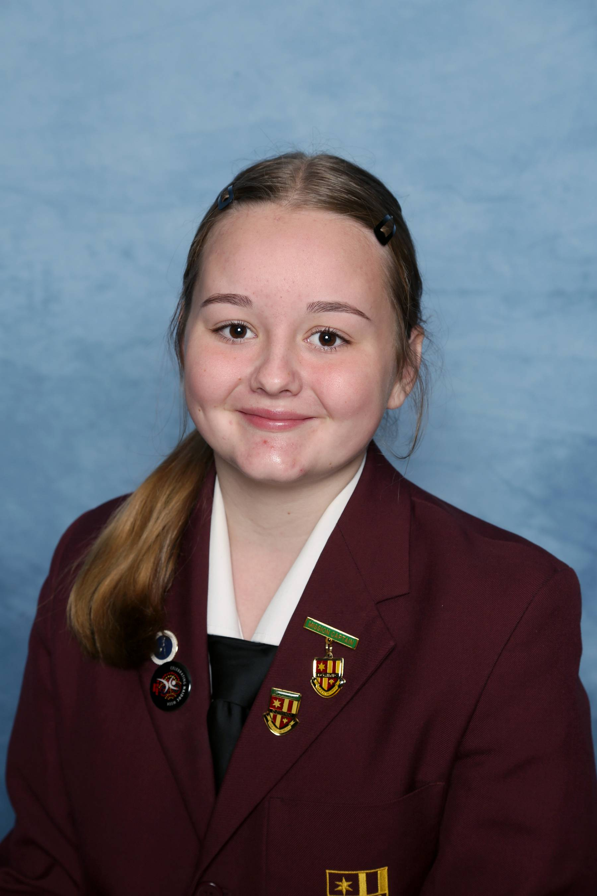
Carys Lavia
Year 8 Electives
Design in Wood
Design in Metal
Drama
Dance
Year 9 Electives
Commerce
Outdoor Education
Mathematics Extension
Year 10 Electives
Animal Husbandry and Marine Studies
Drama
Introduction to Psychology & Sociology

Slide 11
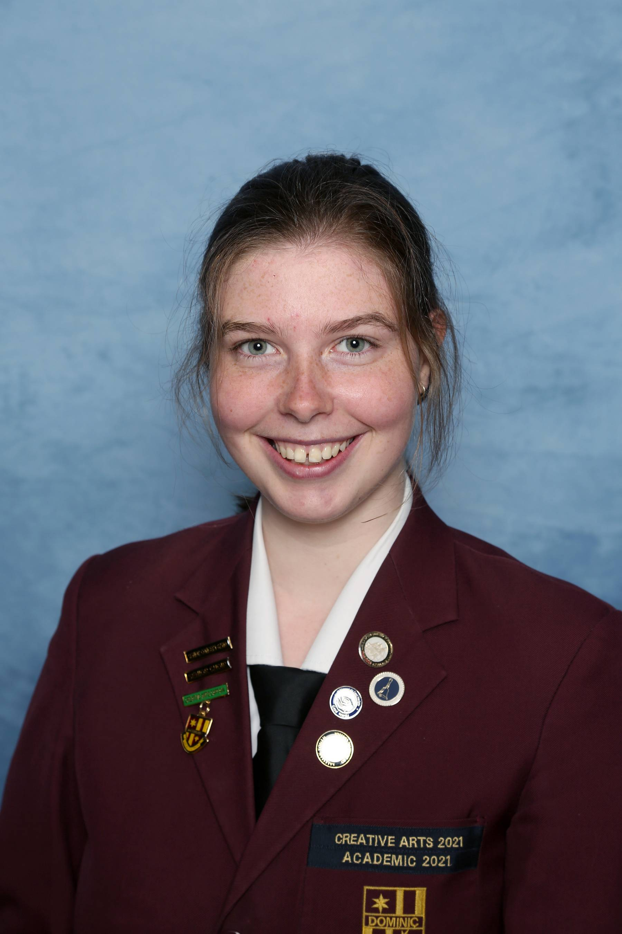
Jasmine Good
Year 8 Electives
Design in Wood
Home Economics
Music
Visual Art
Year 9 Electives
Music
Design in Wood
Mathematics Extension
Year 10 Electives
Mathematics 10A Plus
Visual Art
Introduction to Construction (VET)

Slide 12
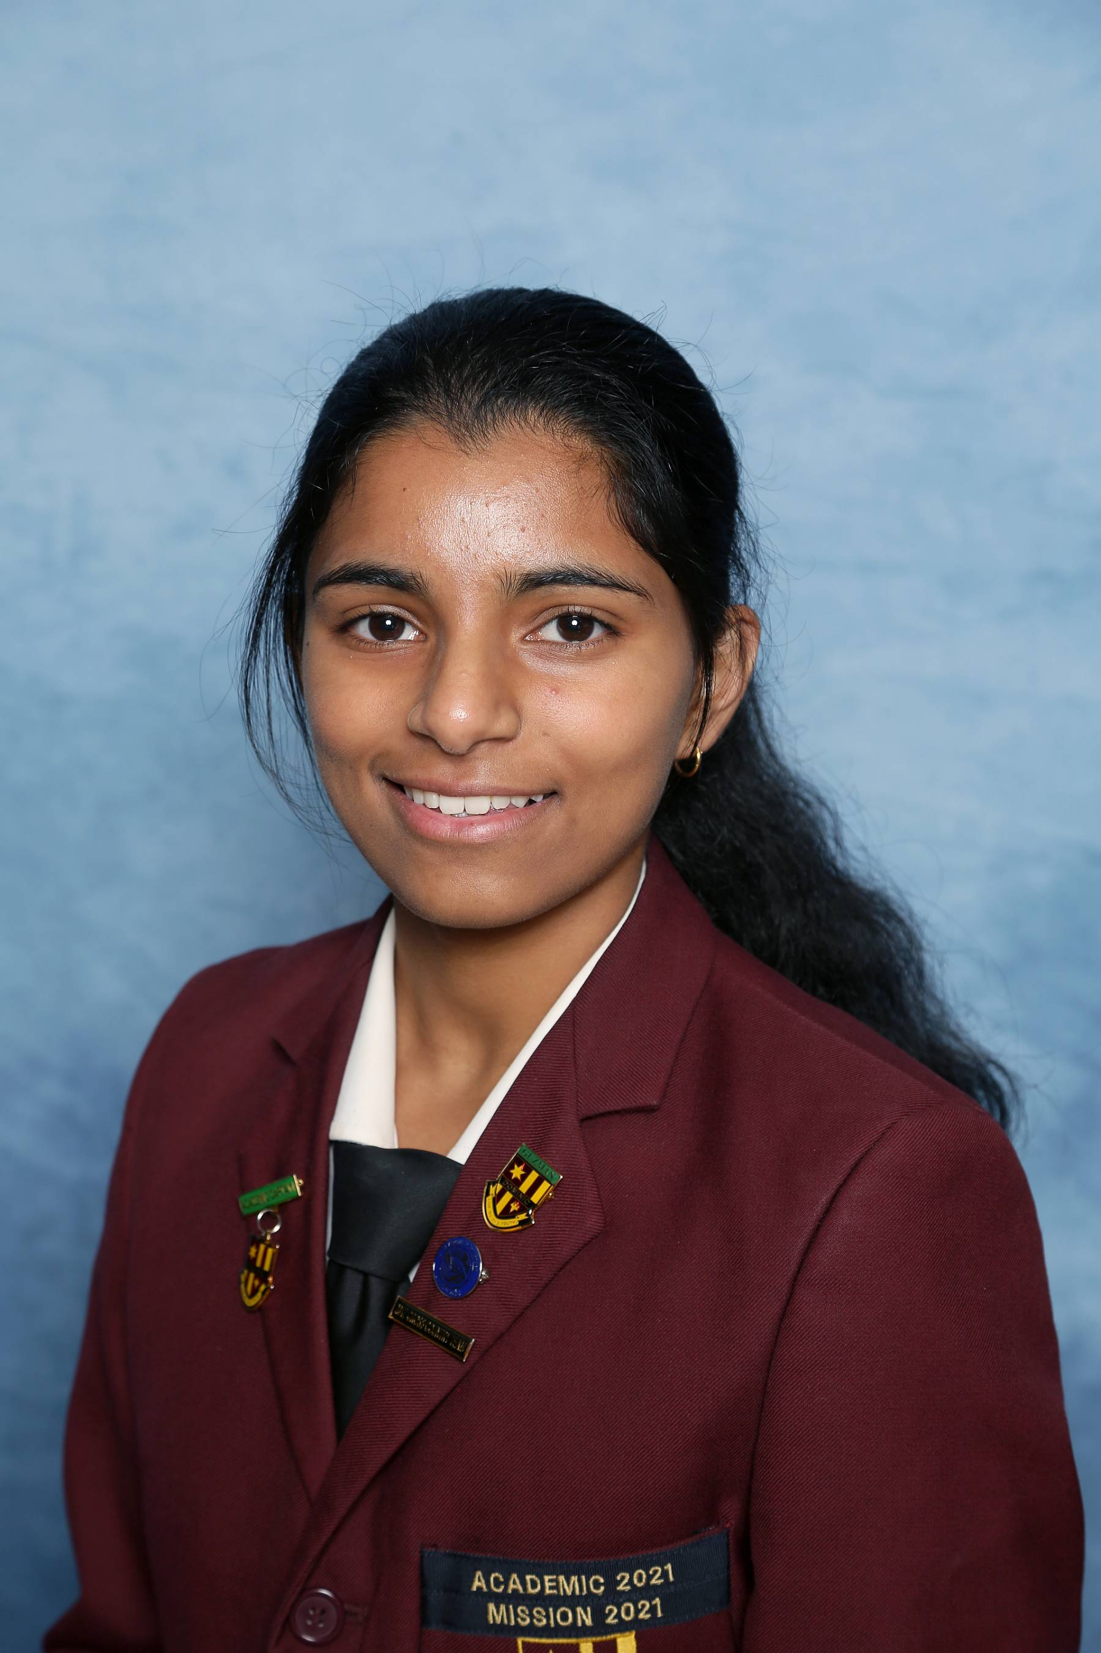
Priyanka Jibi
Year 8 Electives
Design in Wood
Home Economics
Drama
Visual Art
Year 9 Electives
Media Arts
Sport Science
Mathematics Extension
Year 10 Electives
Mathematics 10A Plus
Life Sciences
Sport Science

Slide 13
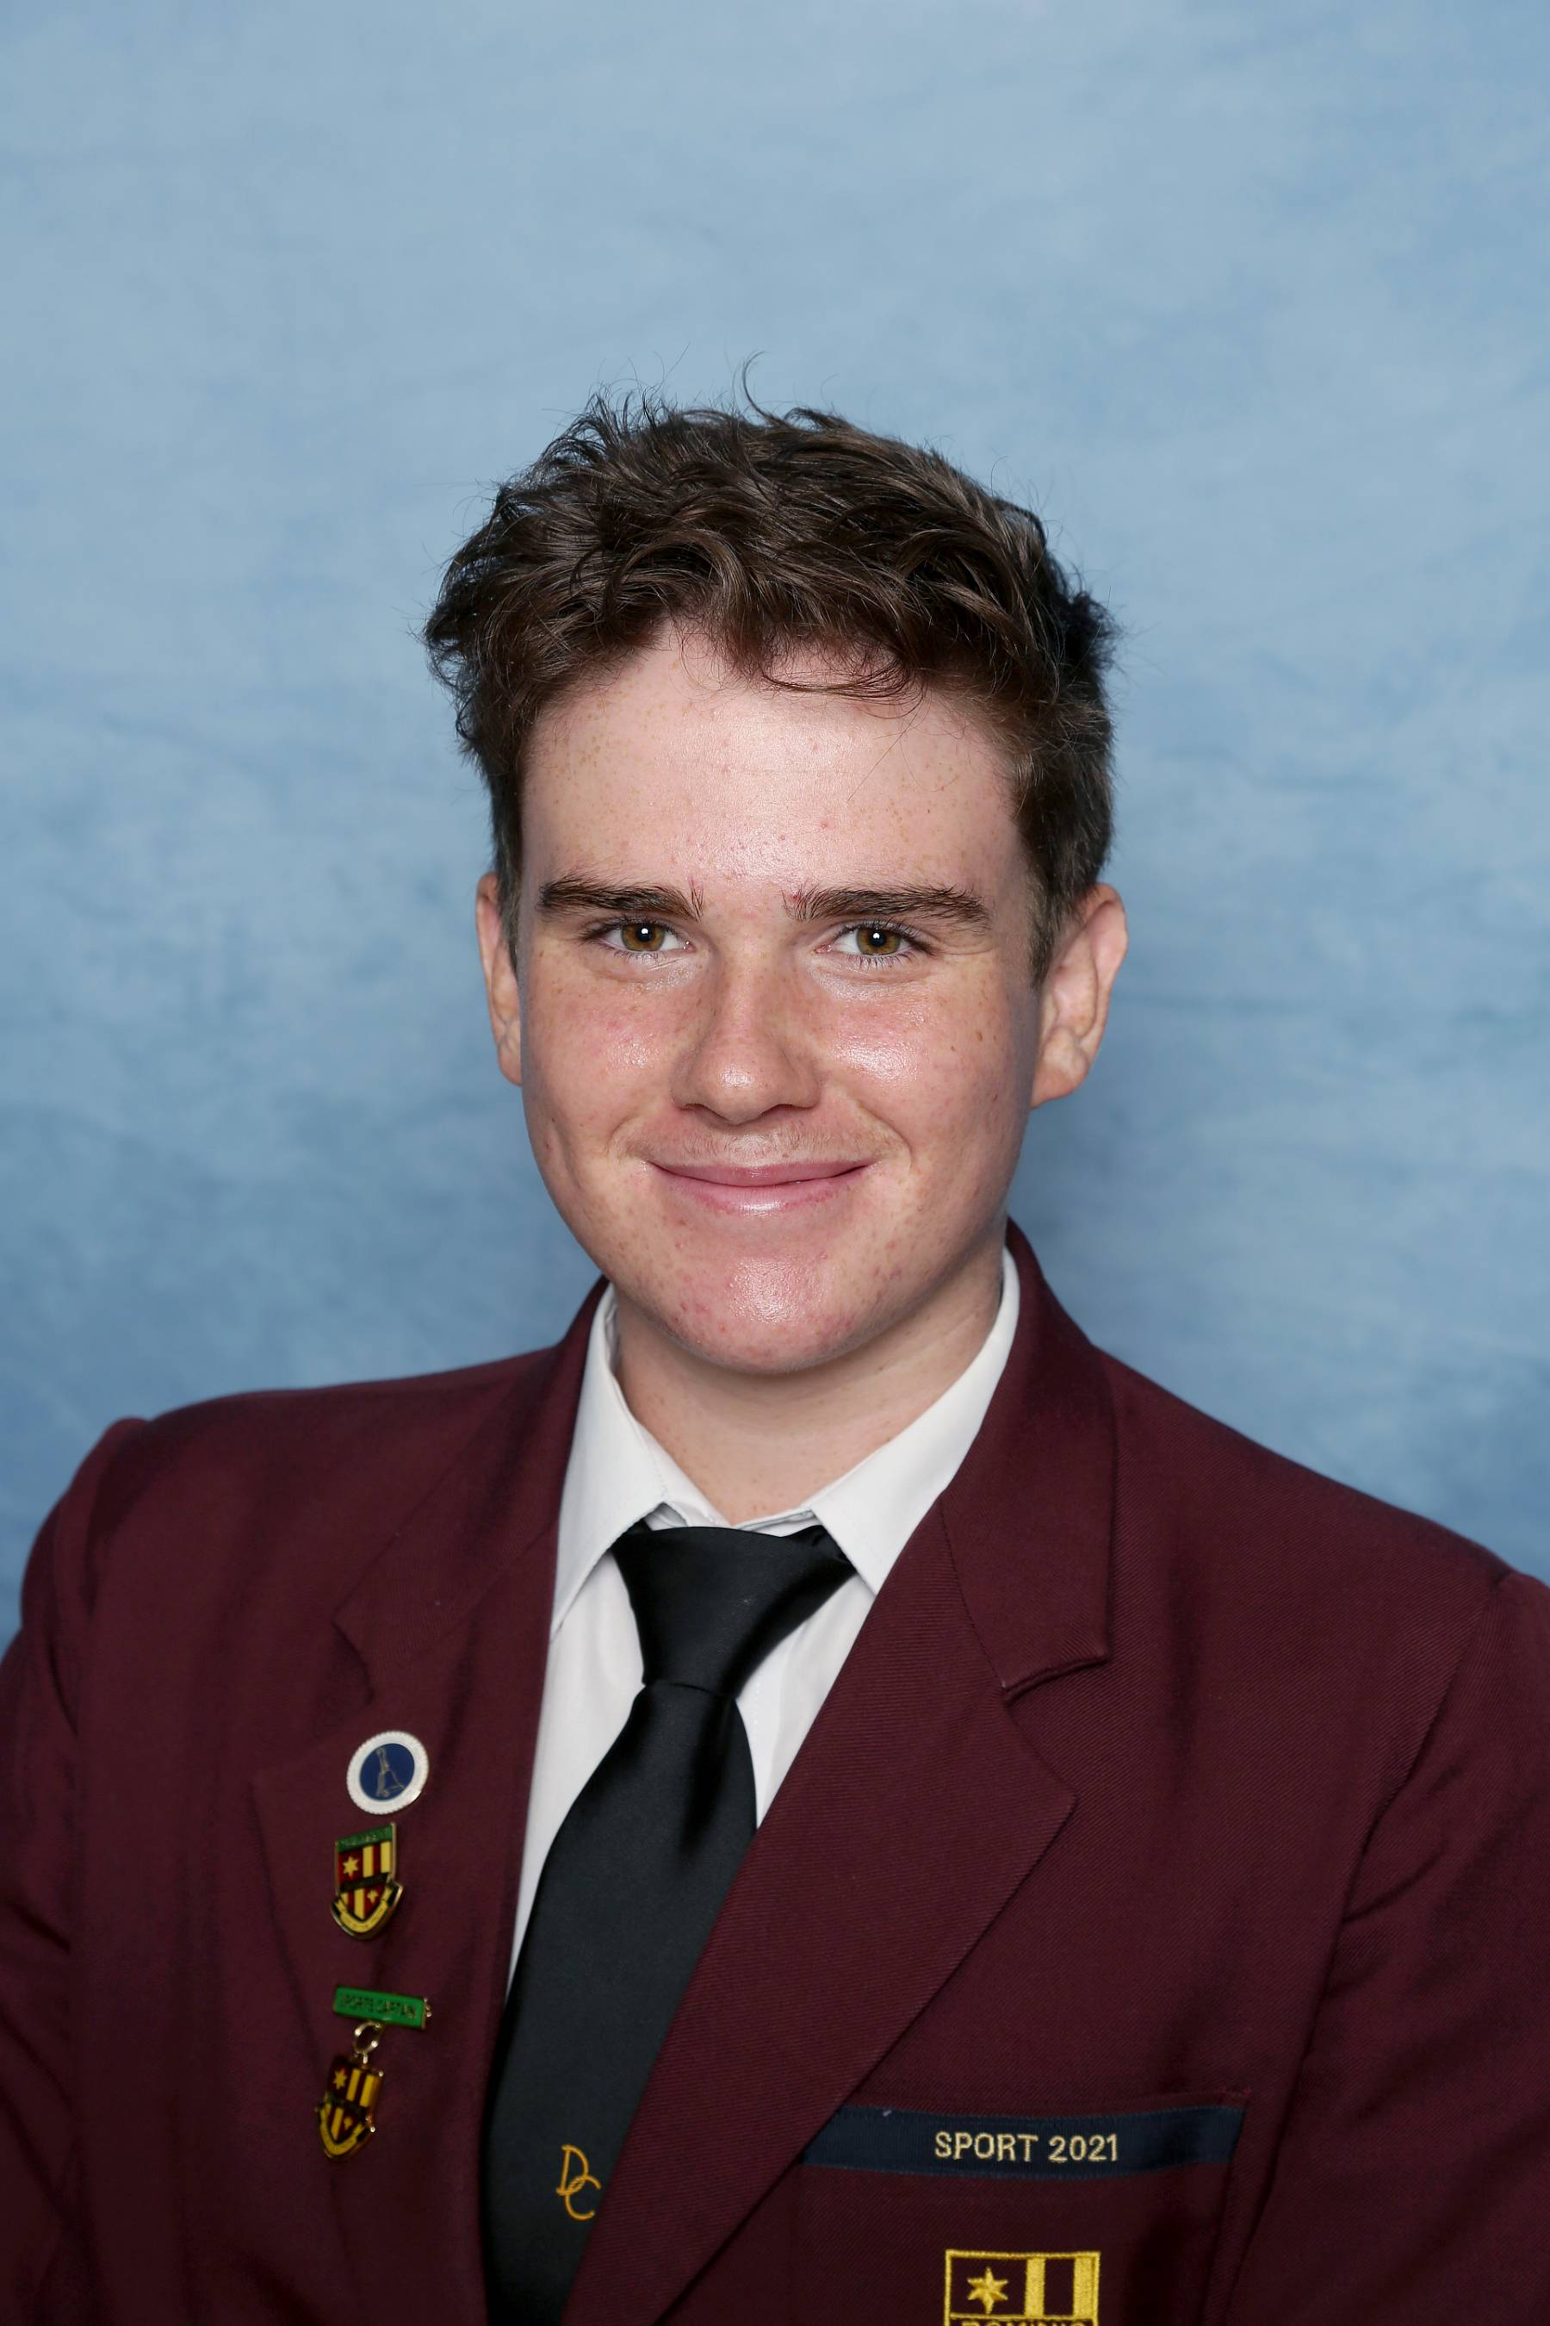
Tomas Murray
Year 8 Electives
Digital Technologies
Home Economics
Japanese
Music
Year 9 Electives
Food Technology
Media Arts
Outdoor Education
Year 10 Electives
Commerce
Physical Sciences
Sport Science

Slide 14
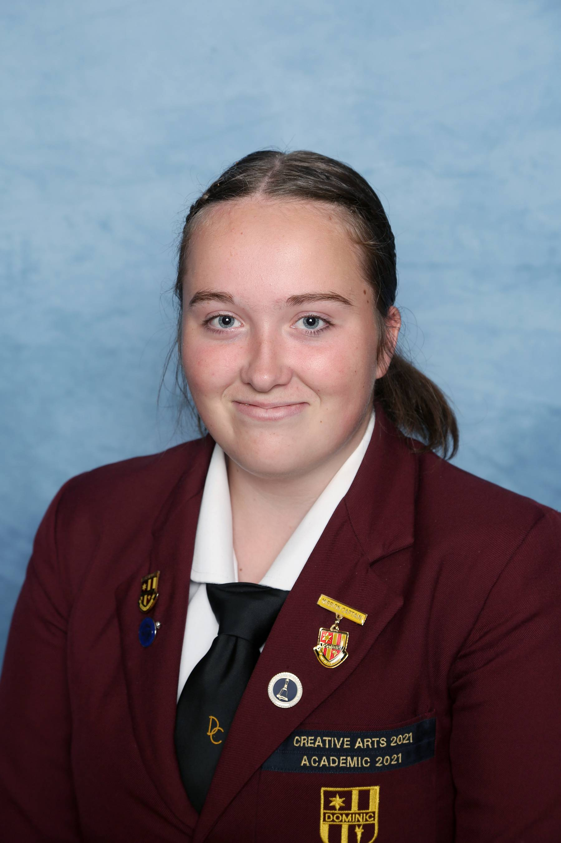
Bianca Russell
Year 8 Electives
Digital Technologies
Home Economics
Drama
Japanese
Year 9 Electives
Athletic Development
Drama
Mathematics Extension
Year 10 Electives
Drama
Introduction to Psychology & Sociology
Sport Science

Slide 15
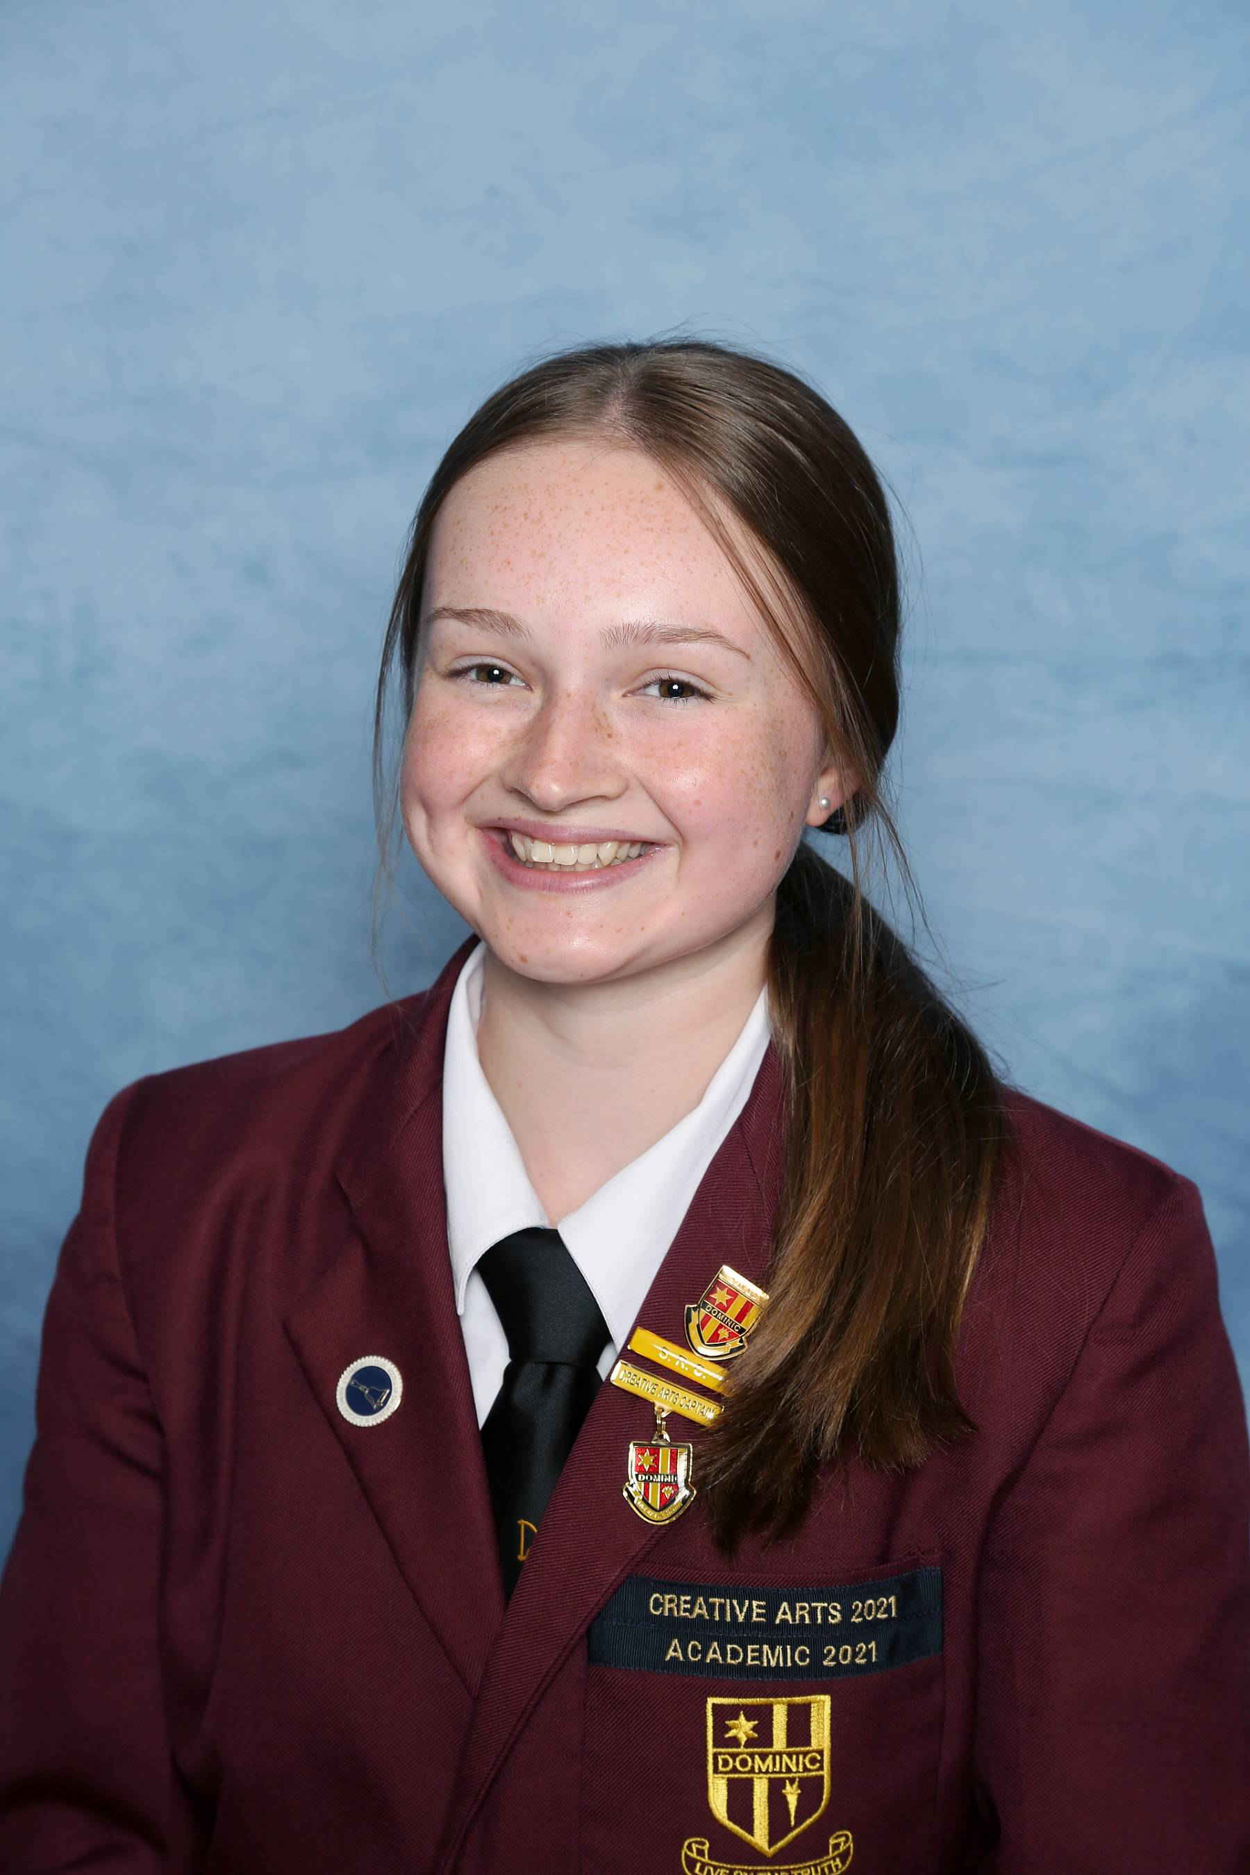
Hannah Lane MacDonald
Year 8 Electives
Dance
Home Economics
Music
Visual Art
Year 9 Electives
Athletic Development
Dance
Sport Science
Year 10 Electives
Athletic Development
Dance
Sport Science

Slide 16
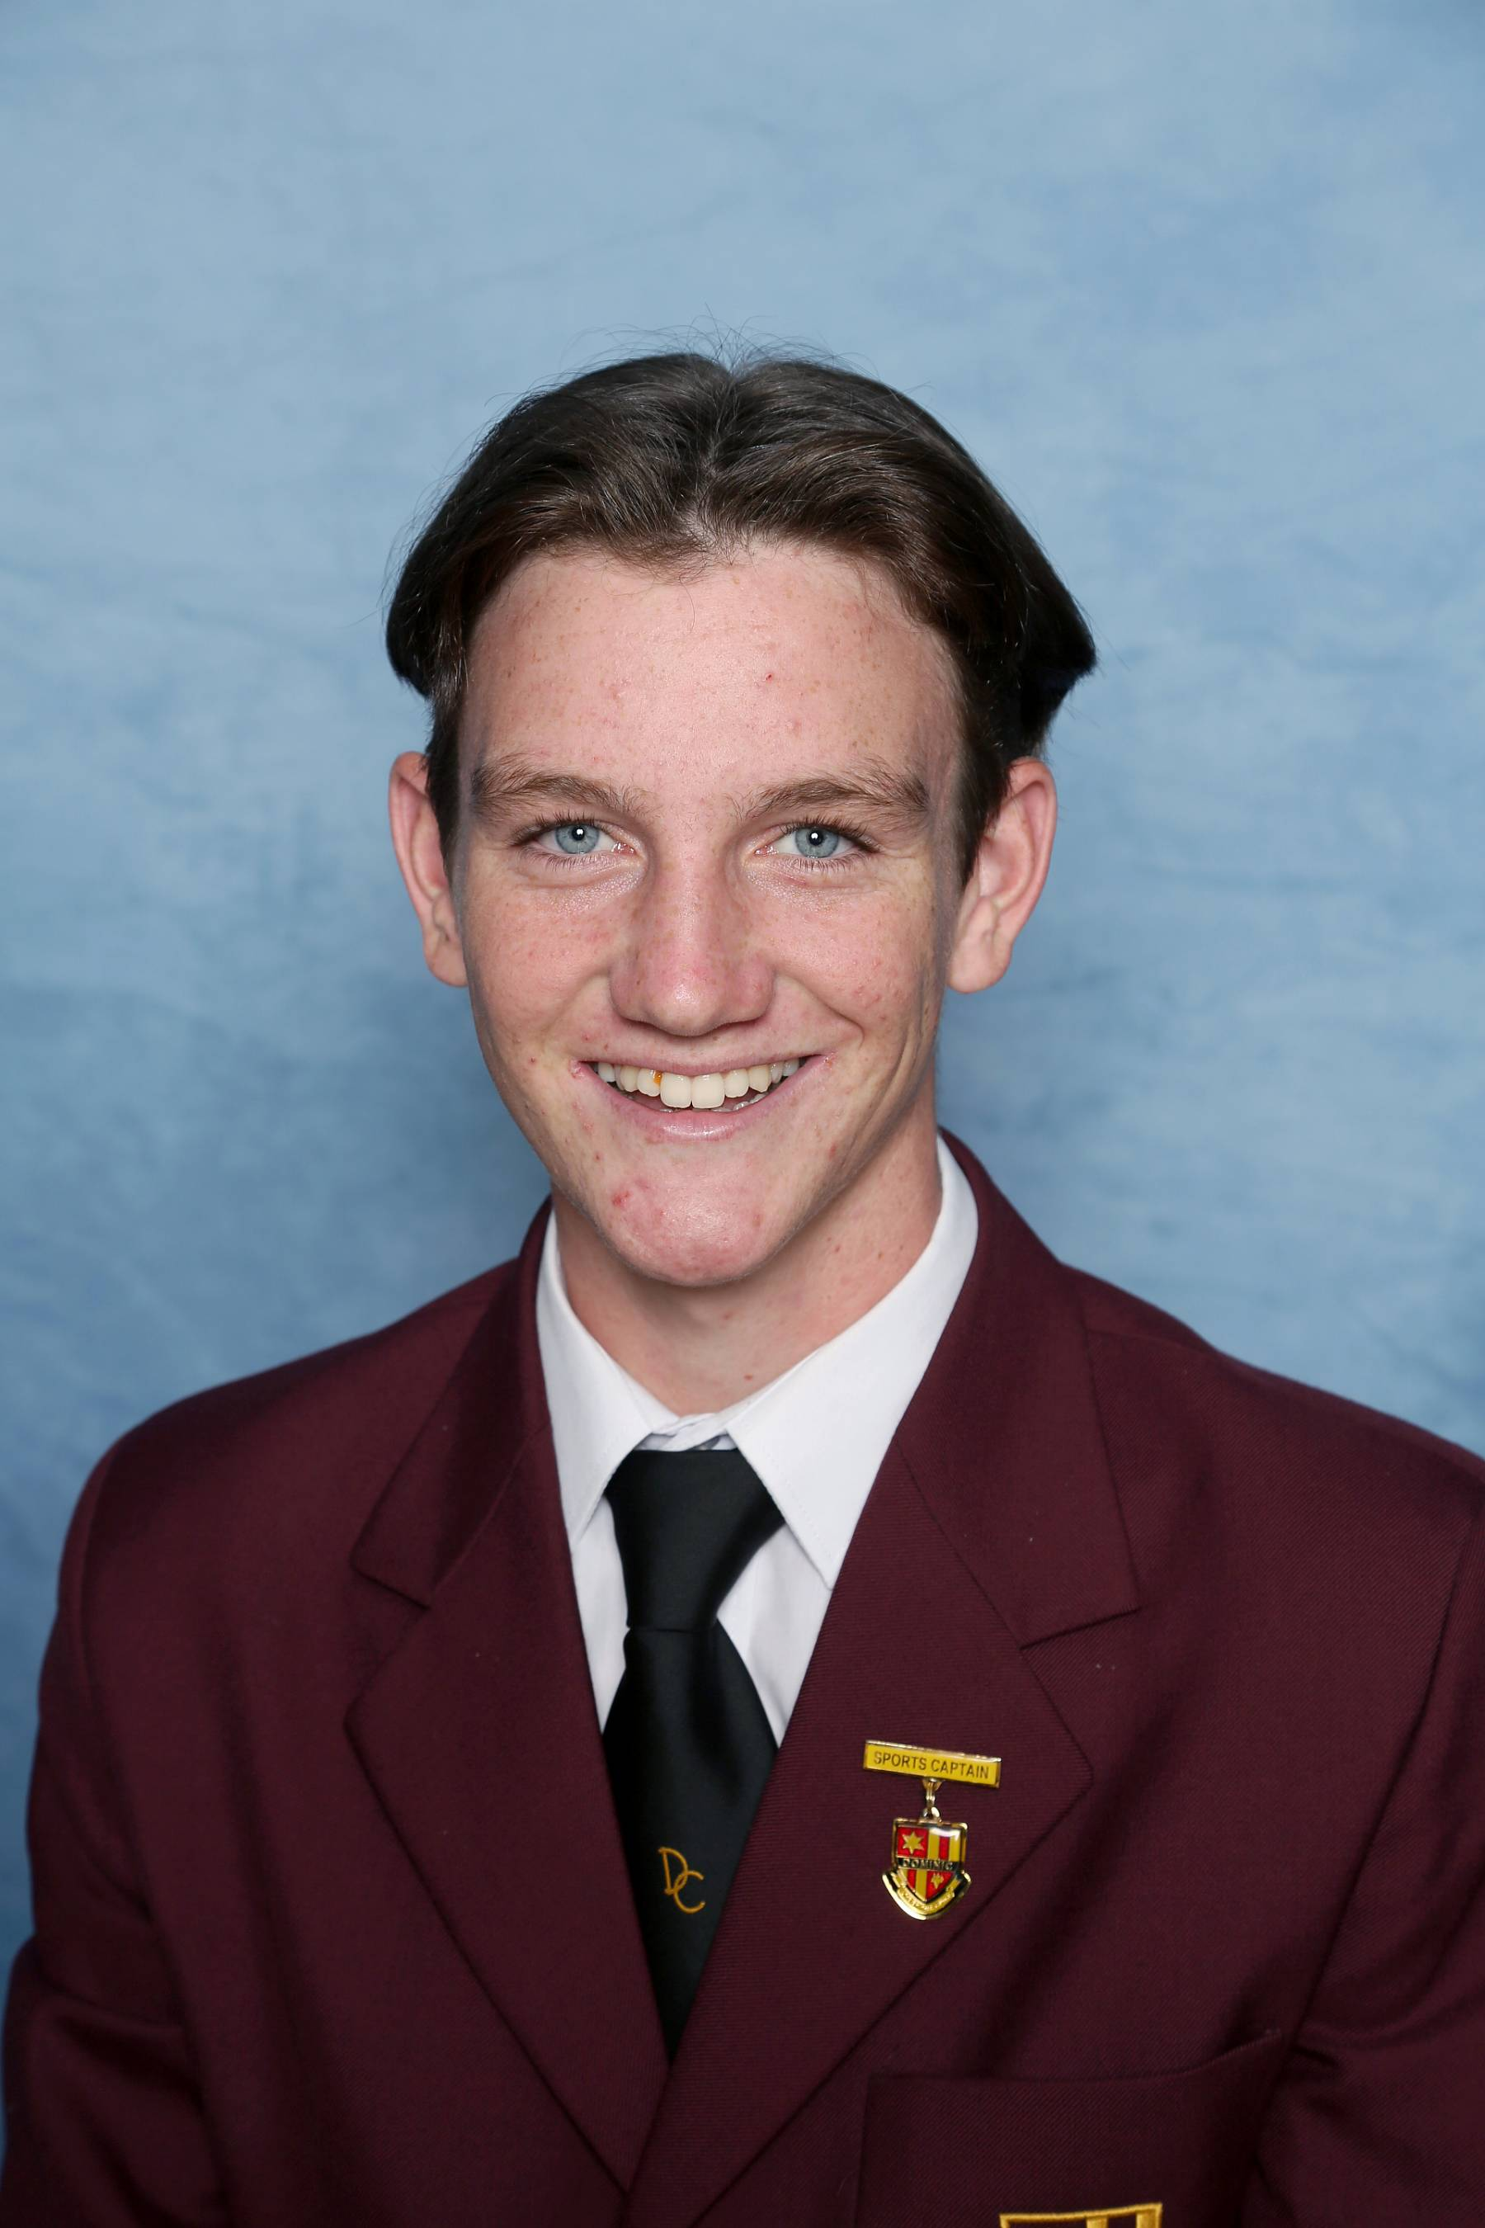
Kitean Aitken
Year 9 Electives
Animal Husbandry & Marine Studies
Design in Wood
Outdoor Education
Year 10 Electives
Animal Husbandry & Marine Studies
Athletic Development
Introduction to Construction (VET)

Slide 17
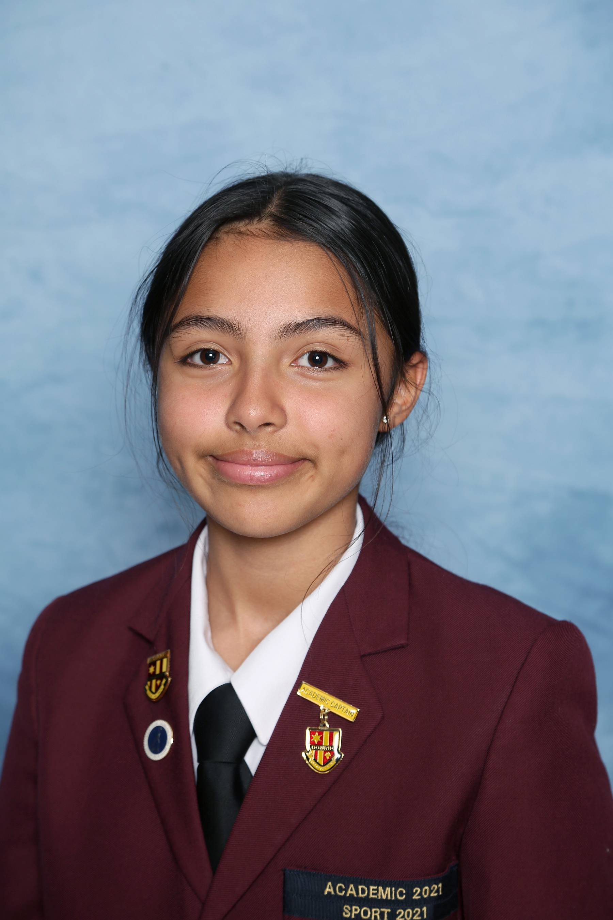
Andrea Escobar
Year 8 Electives
Drama
Home Economics
Visual Art
Music
Year 9 Electives
Introduction to Psychology and Sociology
Mathematics Extension
Sport Science
Year 10 Electives
Mathematics 10A Plus
Physical Sciences
Visual Art

Slide 18
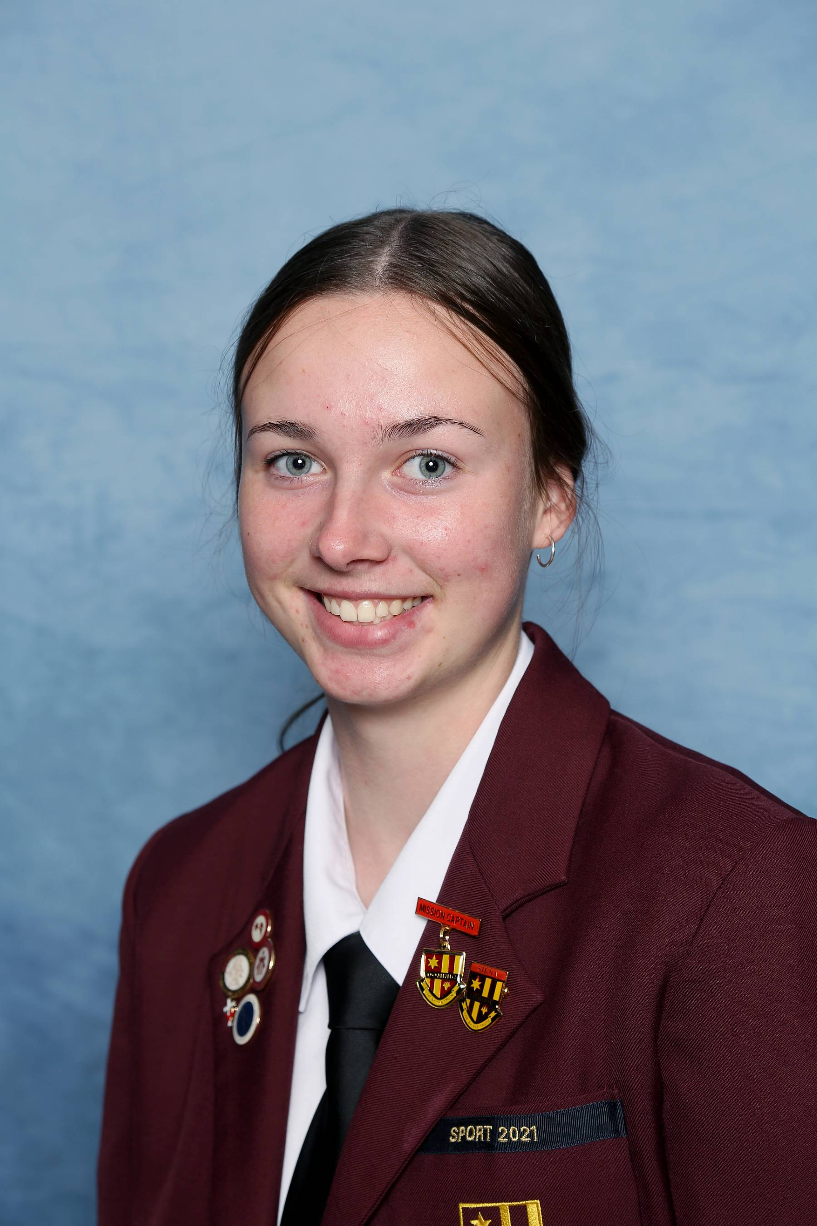
Taylah Chick
Year 8 Electives
Dance
Design in Wood
Visual Art
Music
Year 9 Electives
Athletic Development
Dance
Sport Science
Year 10 Electives
Athletic Development
Sport Science
Dance

Slide 19
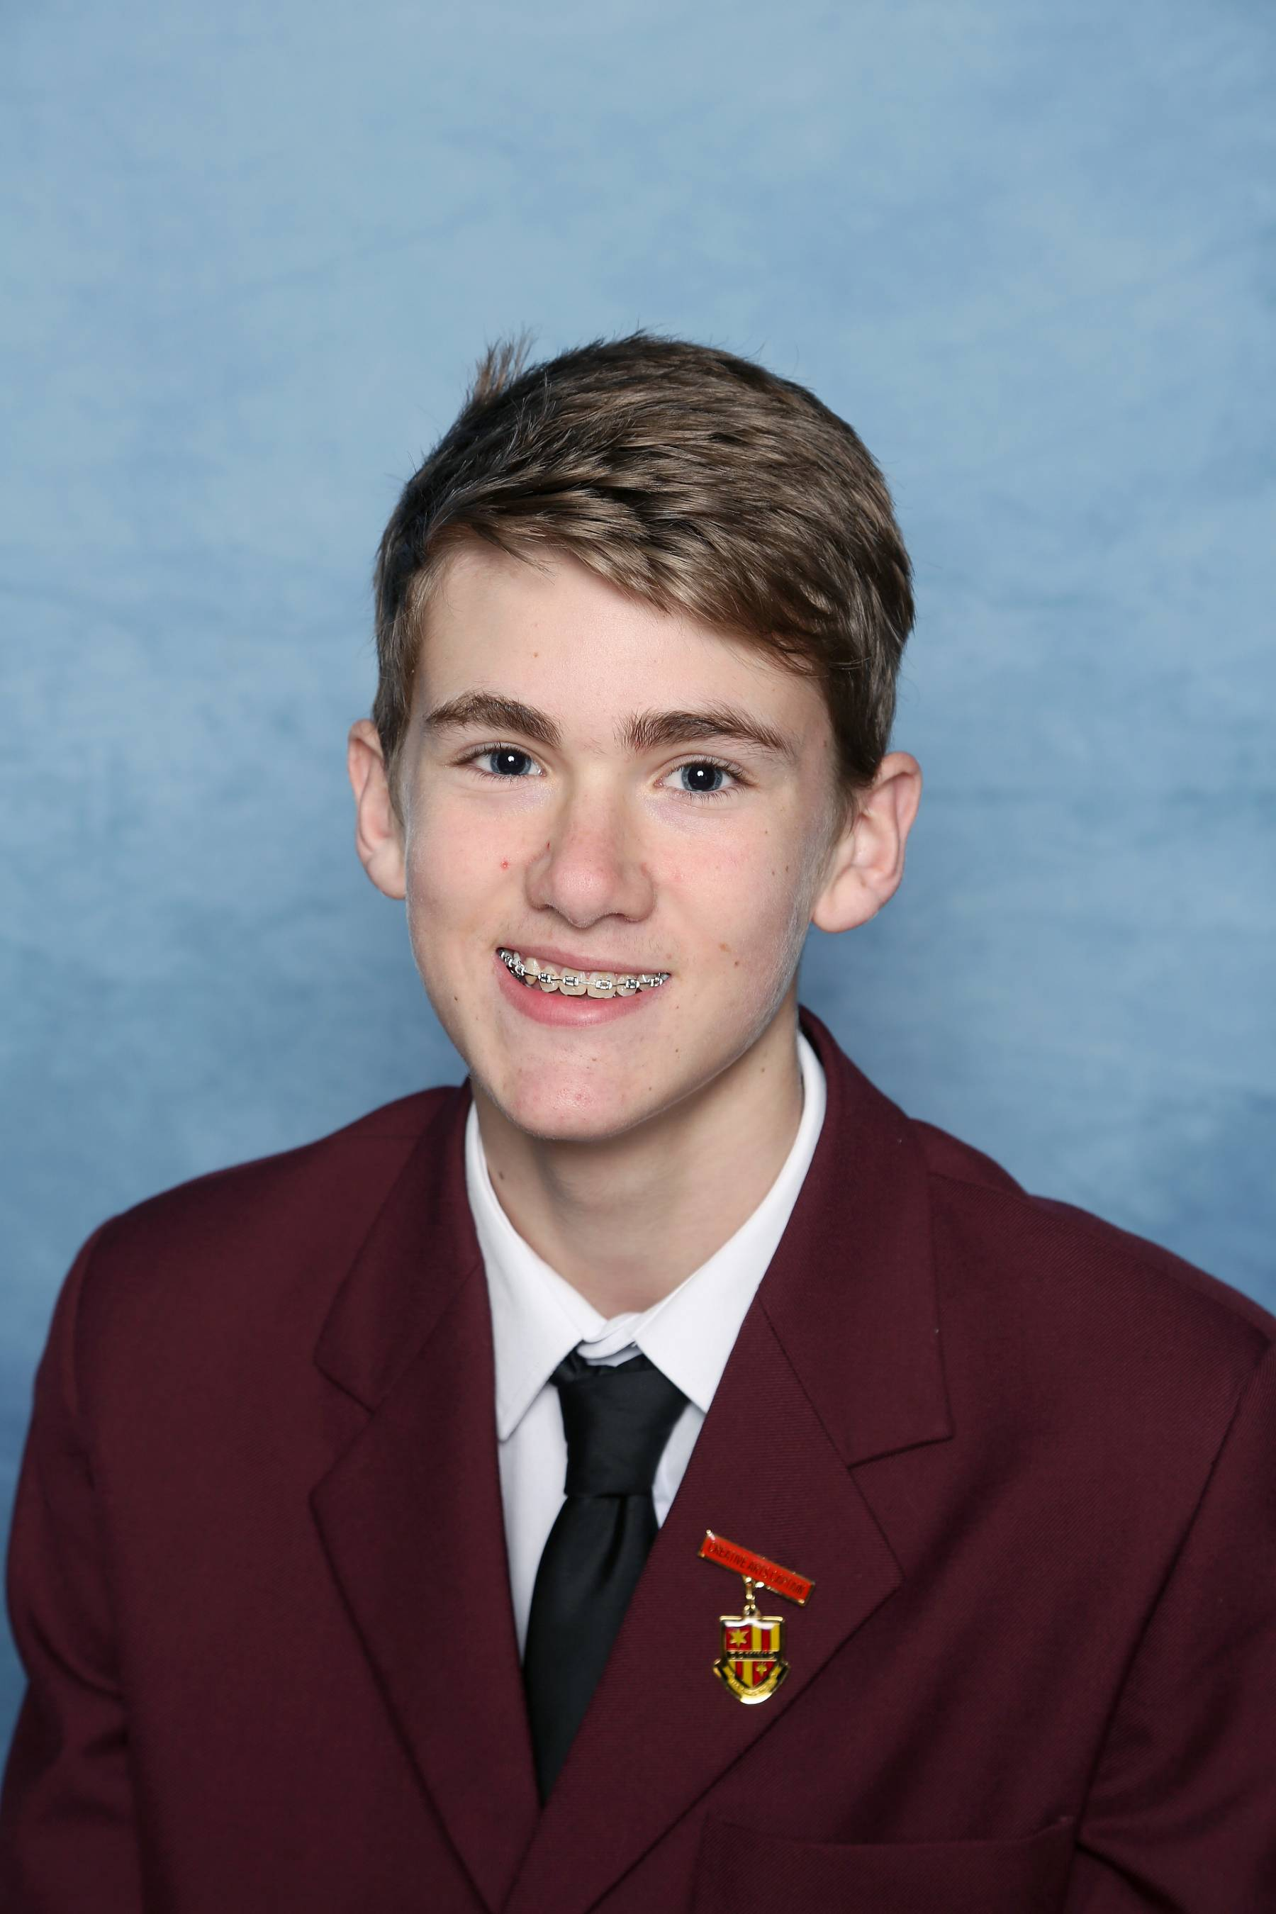
Lachlan Majchrzak
Year 8 Electives
Digital Technologies
Design in Wood
Visual Art
Music
Year 9 Electives
Athletic Development
Music
Mathematics Extension
Year 10 Electives
Athletic Development
Physical Sciences
Robotics & Game Making

Slide 20
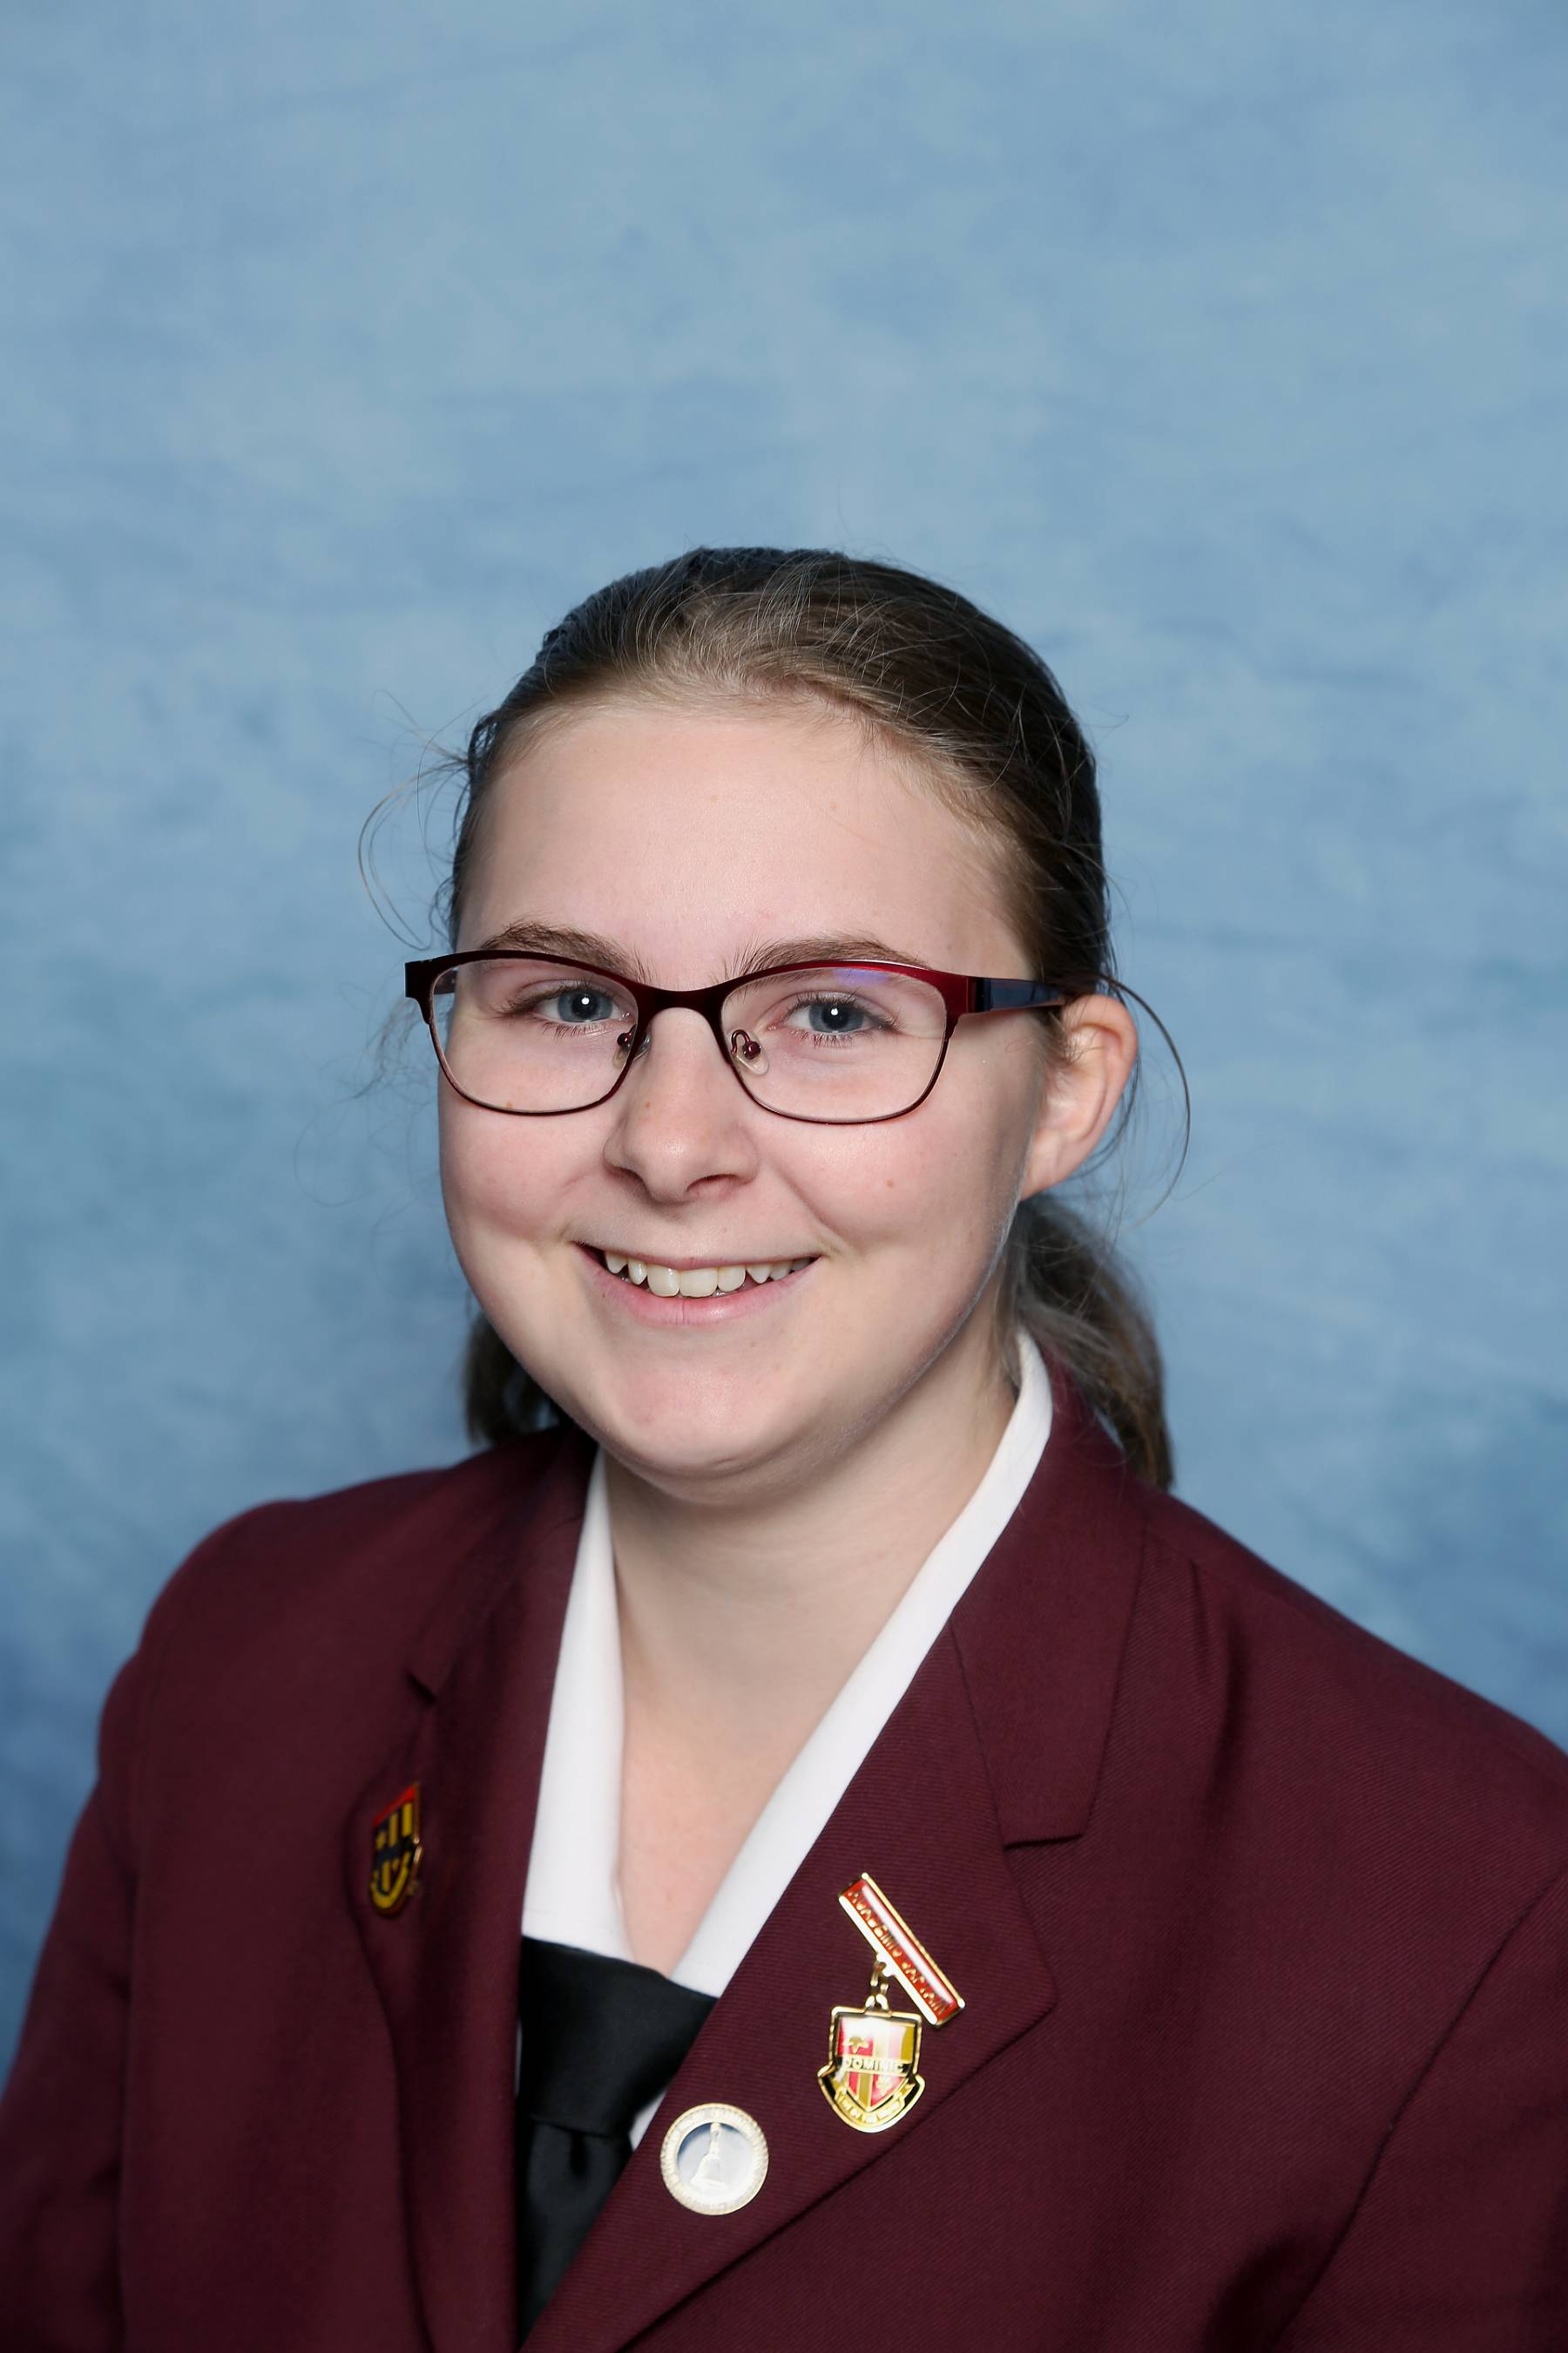
Alexa Sayer
Year 8 Electives
Drama
Home Economics
Visual Art
Music
Year 9 Electives
Creative Writing
Music
Food Technology
Year 10 Electives
Creative Writing
Introduction to Psychology & Sociology
Mathematics Extension

Slide 21
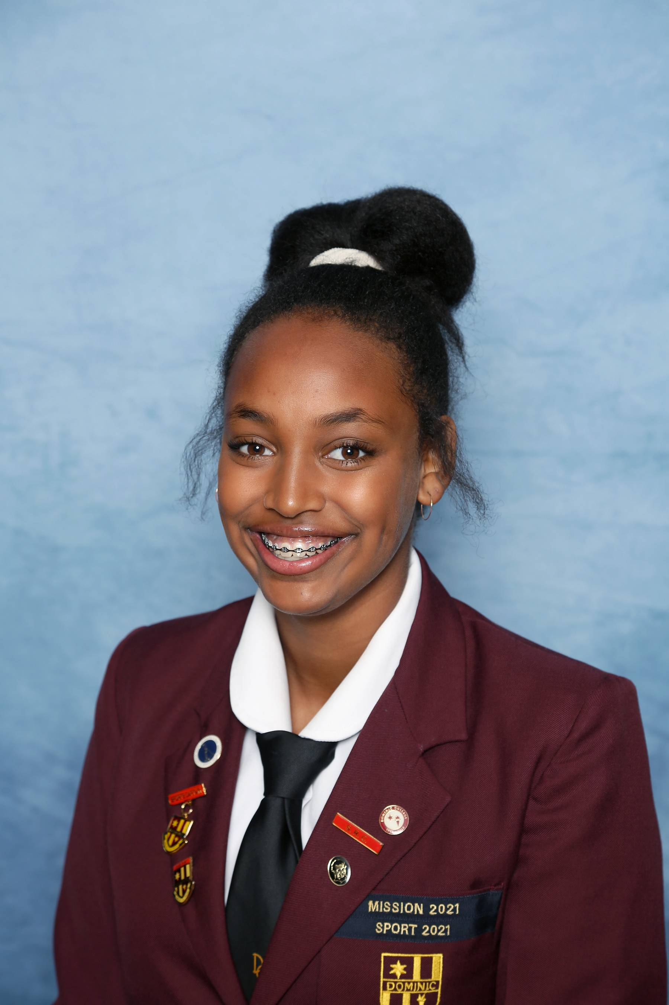
Hawi Bowerman
Year 8 Electives
Drama
Home Economics
Dance
Music
Year 9 Electives
Athletic Development
Dance
Sport Science
Year 10 Electives
Dance
Introduction to Psychology & Sociology
Outdoor Education

